Slide 1

The Internet
Momentum Digital Basics

Slide 2

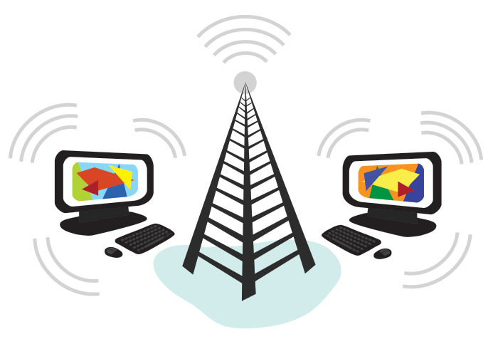
What is the internet?
The difference between the internet and the World Wide Web

Slide 3
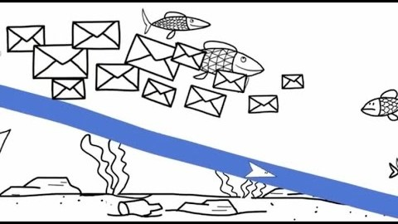
The Internet

Slide 4
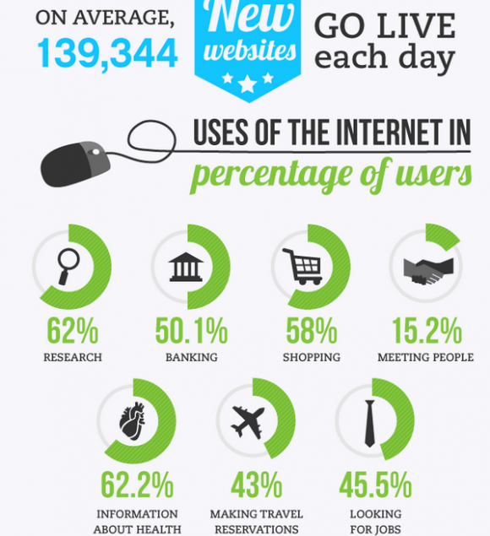
World Wide Web
USES:
Browsing
Web Apps
Cloud Apps
Email
Streaming Music and Video
Academic Activities
Notes:
*Web Browsing
*Web Apps like MS Word and Google Docs-they should be able to work without a constant web connection
*Cloud Apps that require a web connection for any use, Gmail, storage
*Academic Activities like this

Slide 5
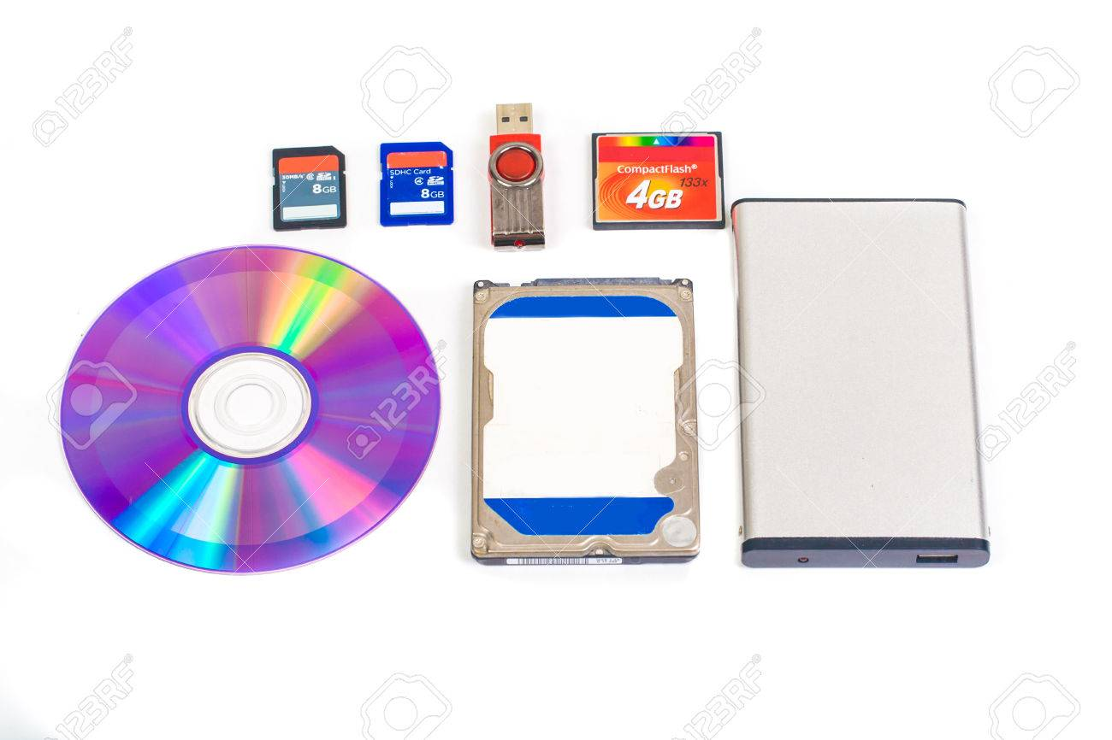
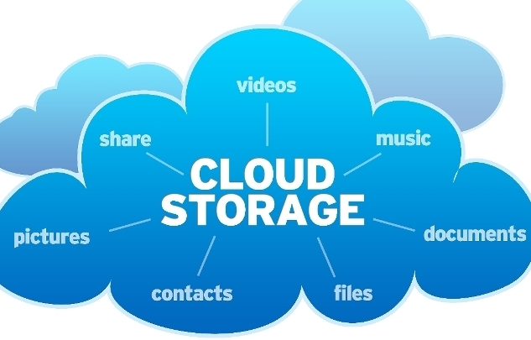
Step Back: Storage
Storage refers to where you, the user, save/store your data physically. (Using magnets and lasers or electricity)
There are THREE main forms of storage.
1.) Internal Storage (Hard Drive C: Drive)
2.)External Storage (Flash Drives, External Hard Drives) →To a lesser extent Discs and mini flash discs (etc.)
3.)Cloud Storage →Use someone else's computer to store your stuff!

Slide 6
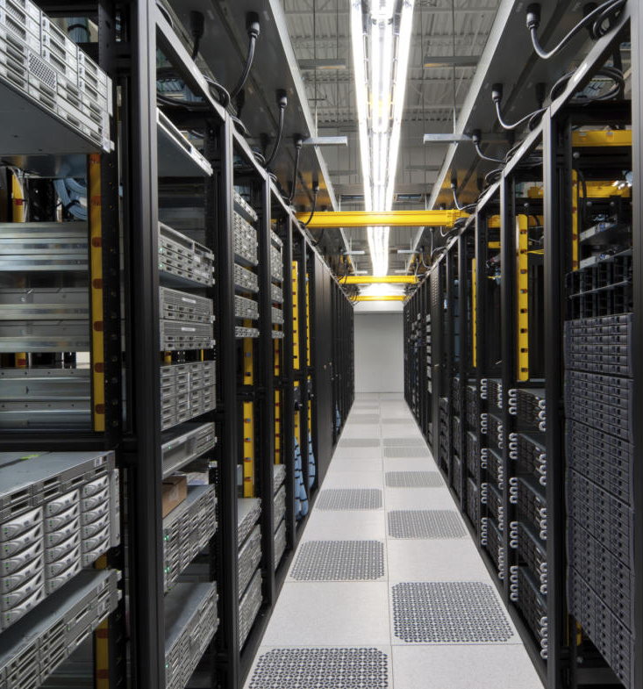

“The Cloud”
Cloud storage is just storing your stuff on someone else's computer.
Cloud apps are just using someone else's computer to do the work.

Slide 7
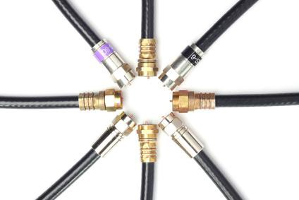
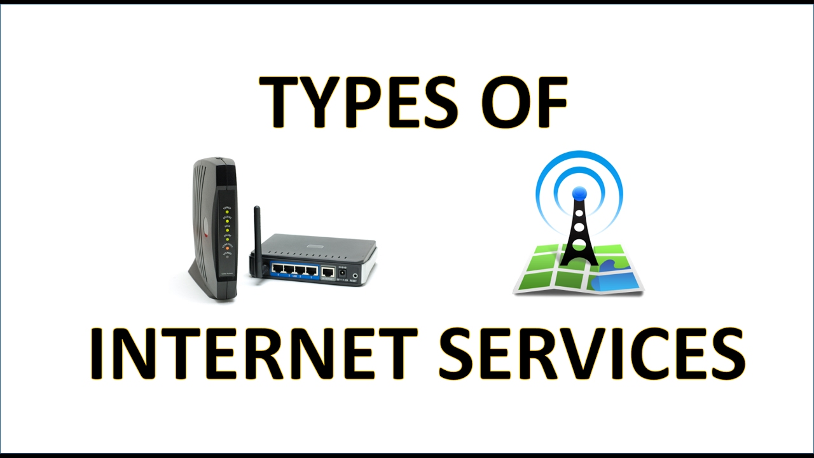
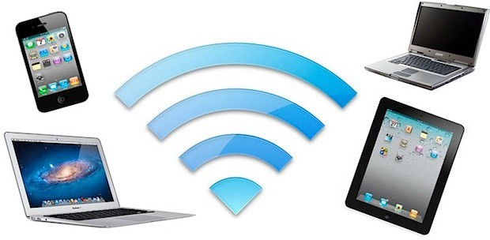
Back Online: Ways to connect
Broadband (Cable/DSL)
Wi-Fi
Cellular Data

Slide 8
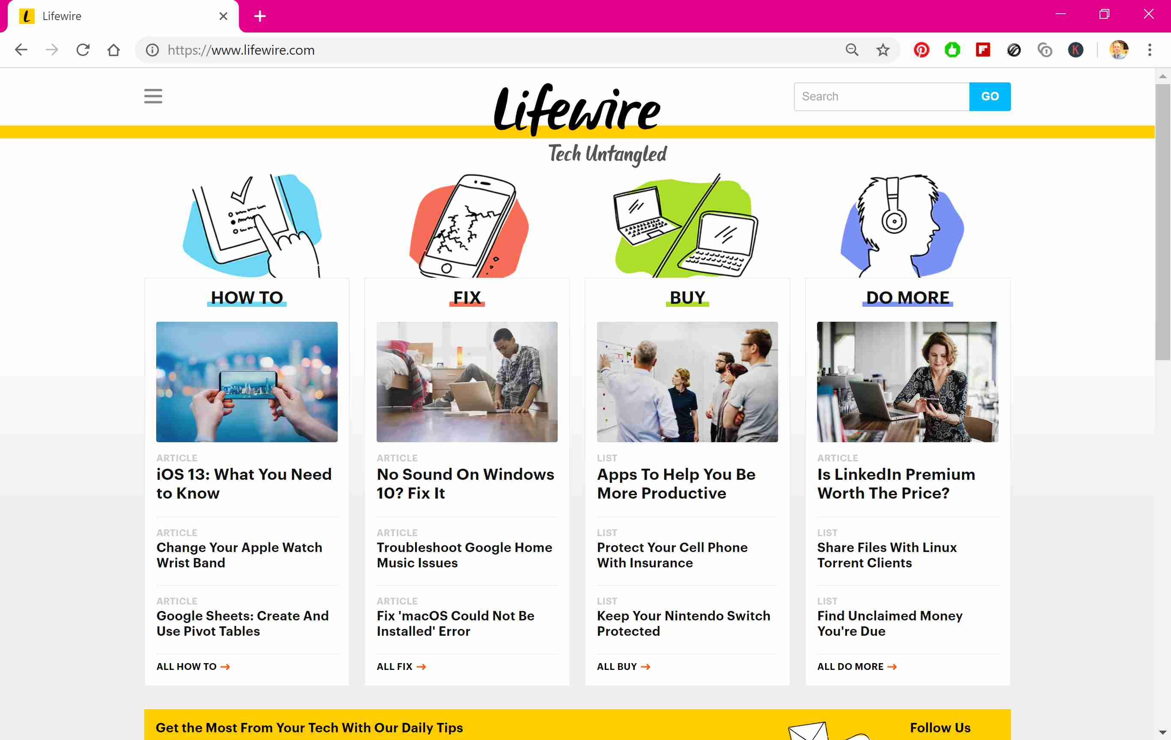
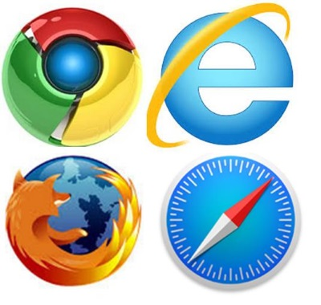
Browsing with…
-Edge
-Firefox
-Safari
-Chrome

Slide 9

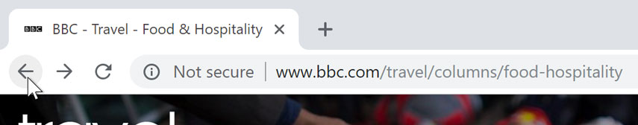
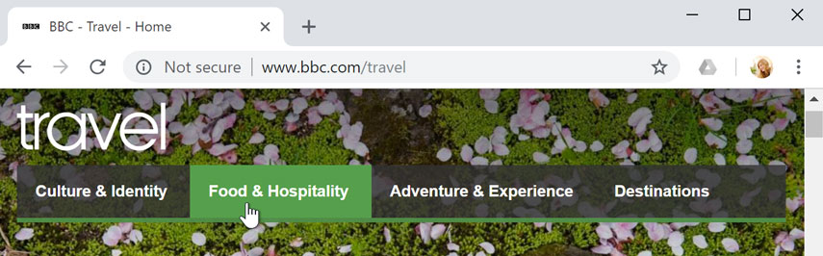
Browser Basics
-Common Browser Functions
URL/Address Bar
Back/Forward and refresh
Hand Icon Means a Link

Slide 10
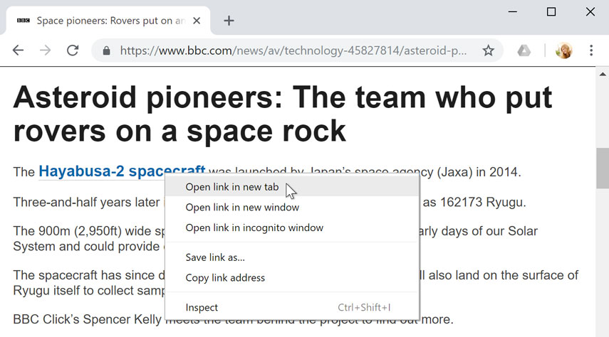


Tabs
Open links in a new tab
Close and Create new tabs
Combine with searches!

Slide 11

Security Concerns
HTTP = UNSECURE!
HTTPS = SECURE
Only provide information to a secure site!!

Slide 12
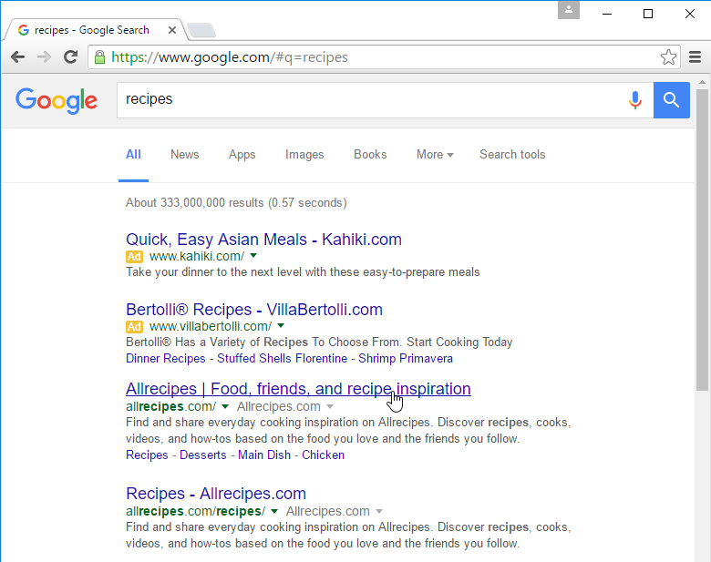
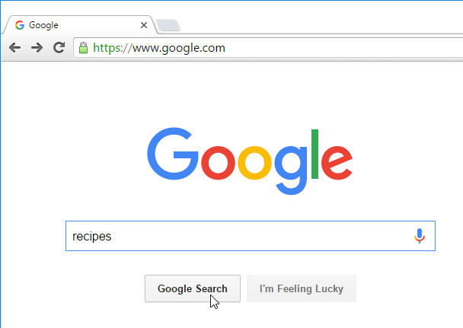
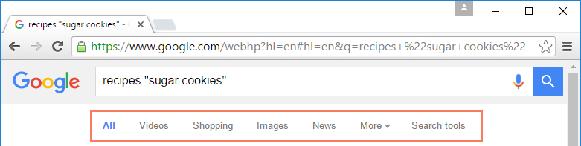
Search Engines

Slide 13
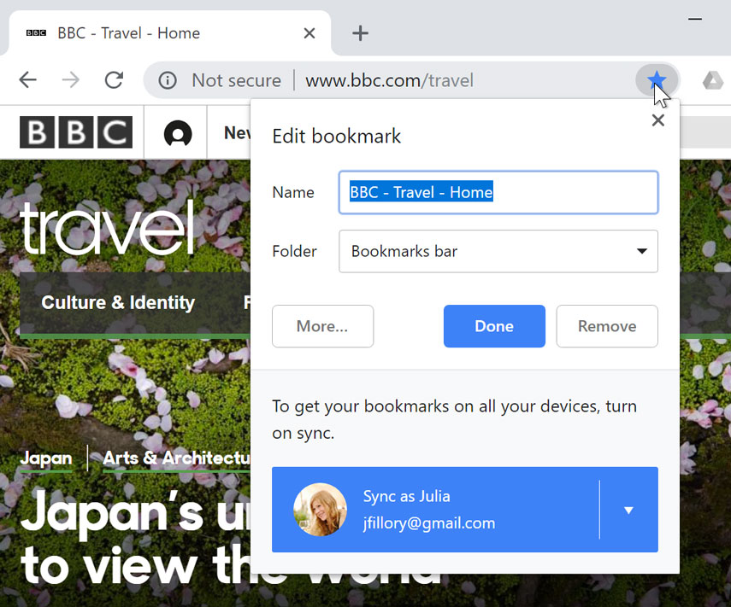
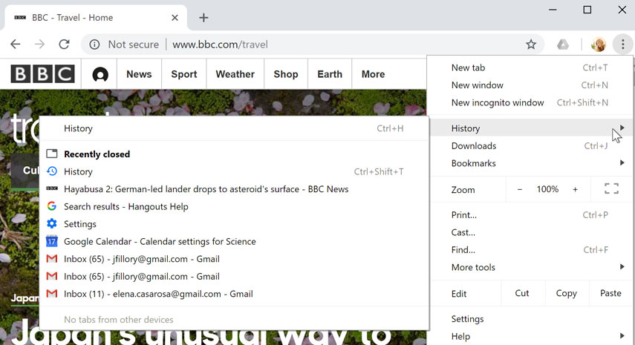
Browser misc.
*Bookmarking *History *Zoom *Find *New Incognito Window

Slide 14
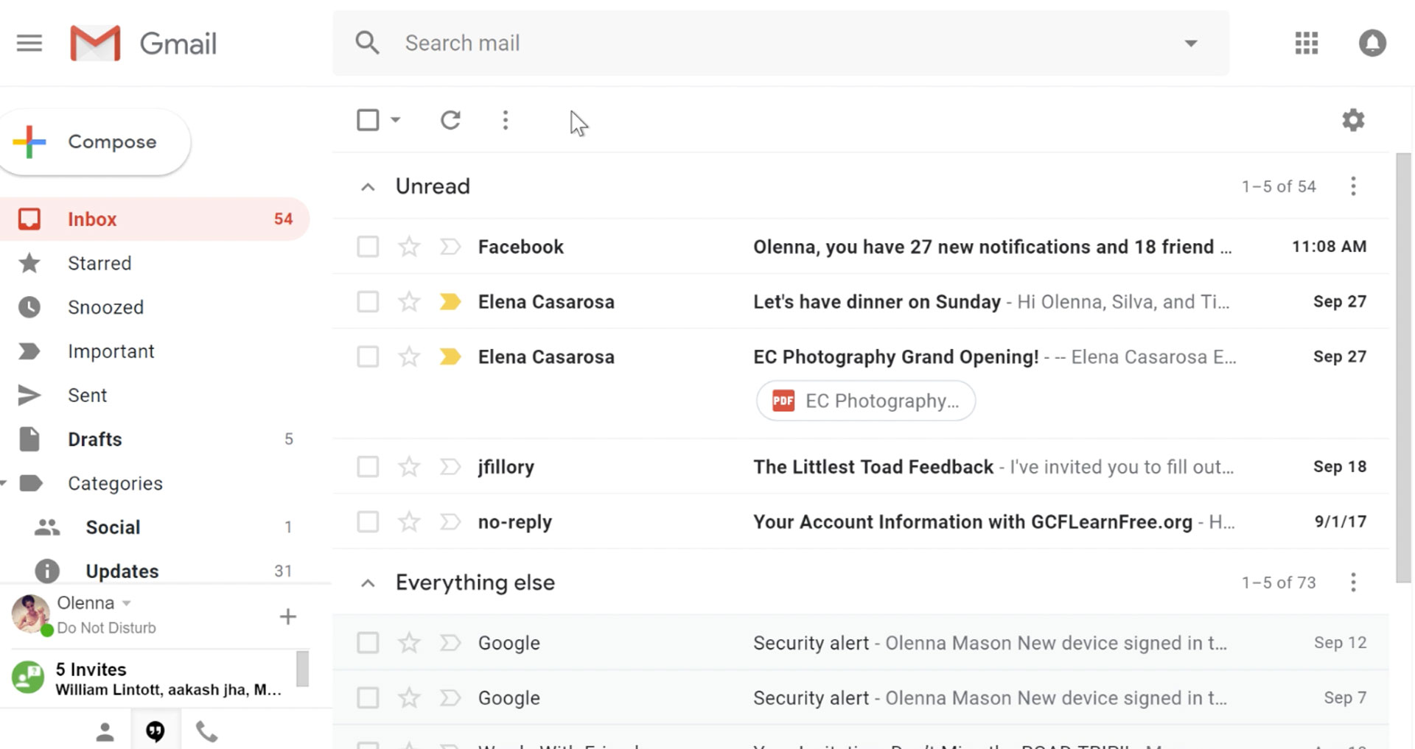
Gmail Basics

Slide 15
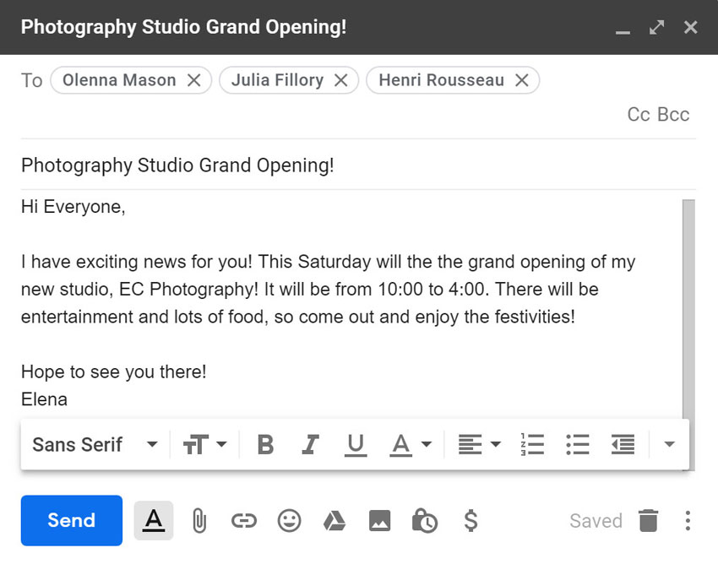
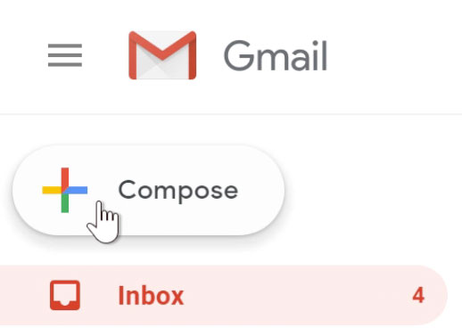
Sending Mail

Slide 16
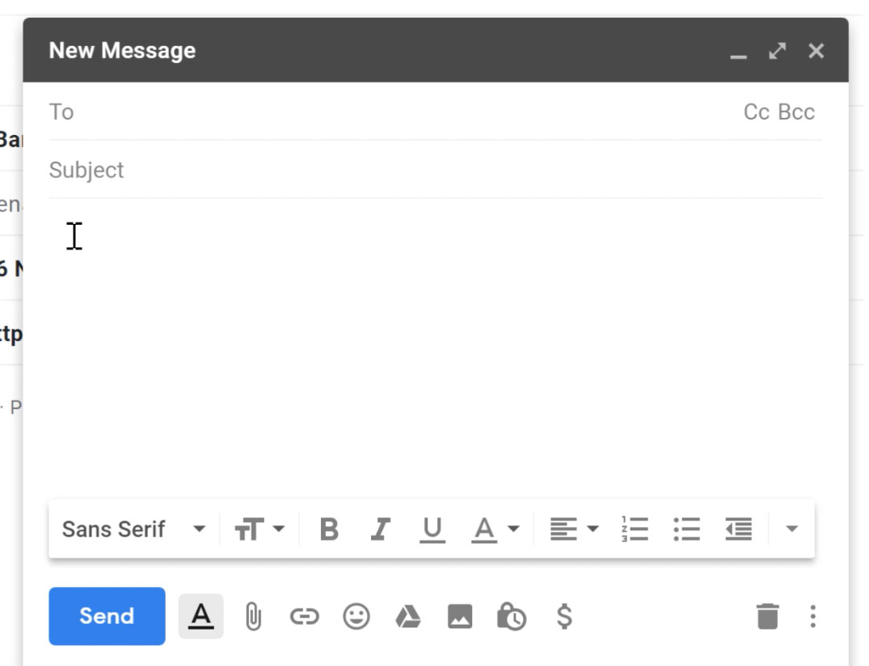
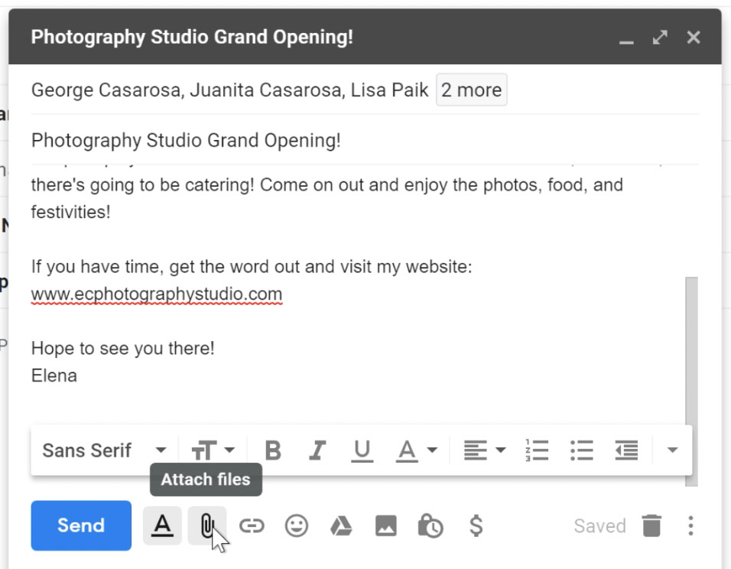
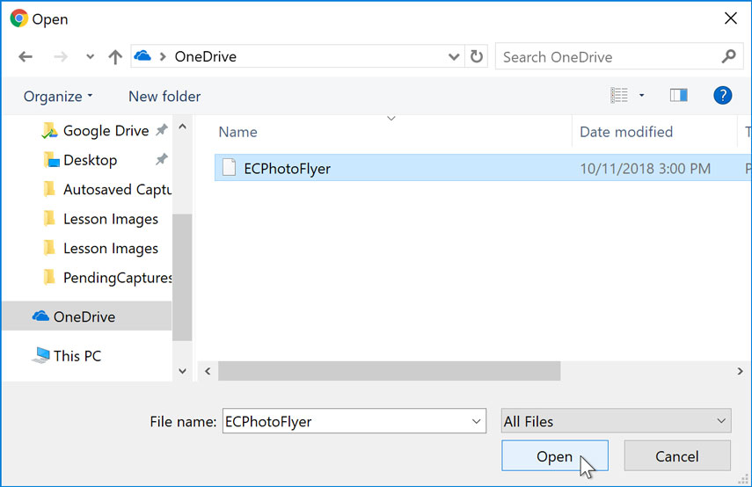
Sending Attachments
Find and click the paperclip icon
Use the open dialogue box to add files

